Slide 1
Web Scraping: Get Product Recommendations with Sentiment Analysis Based on Reviews from Flipkart (Live Data) Using LangChain and Deploying on AWS
Final Project

Slide 2
Problem Statement
To create an automated system that utilizes web scraping and sentiment analysis techniques to provide data-driven product recommendations across different categories, including electronics, clothing, and home appliances.
Key Tasks:
Web Scraping:
Develop a robust scraper to extract product reviews from Flipkart, targeting multiple product categories.
Data Cleaning and Structuring:
Process the scraped data to ensure it is well-structured and suitable for analysis.
Sentiment Analysis:
Implement sentiment analysis to categorize reviews as positive, negative, or neutral, thus providing insights into customer opinions.
Product Recommendation:
Utilize the results of the sentiment analysis to recommend the top products based on customer feedback.
Visualization and Reporting:
Create visual representations of the analyzed data and compile a comprehensive report detailing the analysis process, findings, and recommendations.

Slide 3
Automated Web Scraping
Set Up Environment
Install necessary libraries: BeautifulSoup, Selenium, and Pandas.
Configure ChromeDriver for web scraping.
Identify Target URLs
Select product pages to scrape, focusing on smartphones.
Implement Web Scraping
Use Selenium to automate browser interactions.
Fetch HTML content of product review pages.
Navigate through multiple review pages to gather extensive data.
Extract Relevant Data
Parse HTML using BeautifulSoup to locate review sections.
Collect ratings and review texts for each product.
Structure data into a list of dictionaries for easy manipulation.
Store Data
Save the collected reviews into a CSV file for further analysis.
Phone Name,Product,Review.Rating

Slide 4
Preprocessing and Sentiment Analysis
Import Libraries
Utilize Pandas, BeautifulSoup, NLTK, and TextBlob.
Preprocess Reviews
Remove HTML tags and 'READ MORE' text.
Clean special characters and normalize whitespace.
Convert text to lowercase and tokenize.
Remove stop words and apply lemmatization.
Sentiment Analysis
Use TextBlob to analyze sentiment polarity.
Classify sentiments as Positive(>0), Negative(<0), or Neutral(=0).(based on polarity score) TextBlob determines the overall polarity by analyzing the emotional weight of words in context, adjusting for modifiers or negations, and averaging the sentiment scores to classify the sentiment as positive, neutral, or negative.
Store Results
Add sentiment labels to the DataFrame.
Save the enhanced DataFrame to a new CSV file.

Slide 5
Automated sentiment analysis of reviews and product recommendations
Predict sentiments of Flipkart reviews using DistilBERT and provide product recommendations based on review sentiment and scores.
Dataset and Preprocessing:
Data: Flipkart reviews with sentiment labels.
Sentiment Mapping:
Positive → 2Neutral → 1Negative → 0
Split dataset into train (80%) and test (20%) for model evaluation.
Model:
Transformer Model: DistilBERT (Lightweight BERT-based model) fine-tuned for sentiment classification.
Tokenization: Performed in batches for memory efficiency using DistilBERT tokenizer.
Training Process:
3 epochs Batch size: 16

Slide 6
Sentiment Prediction:
Applied the trained DistilBERT model to predict sentiment for all reviews in the dataset:
Predicted sentiments as Positive, Neutral, or Negative.
Product Score Calculation:
Sentiment Scoring:
Positive: 3 points, Neutral: 2 points, Negative: 1 point.
Review Count: Incorporated into product scoring.
Product Score Formula:
Weighted score: Sentiment (70%) + Review Count (30%).
Product Recommendation System:
Sorted reviews by product scores.
Recommended top 3 products with similar reviews for each product.
Streamlined review-based product recommendation for user decision support.
Sentiment analysis and product scoring to automate recommendations, improving customer experience

Slide 7
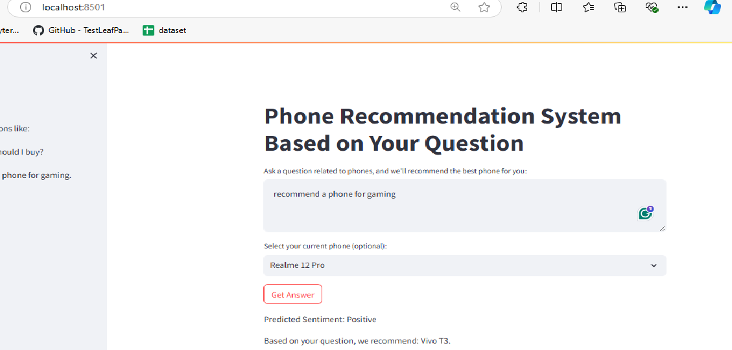
Deployment using streamlit

Slide 8
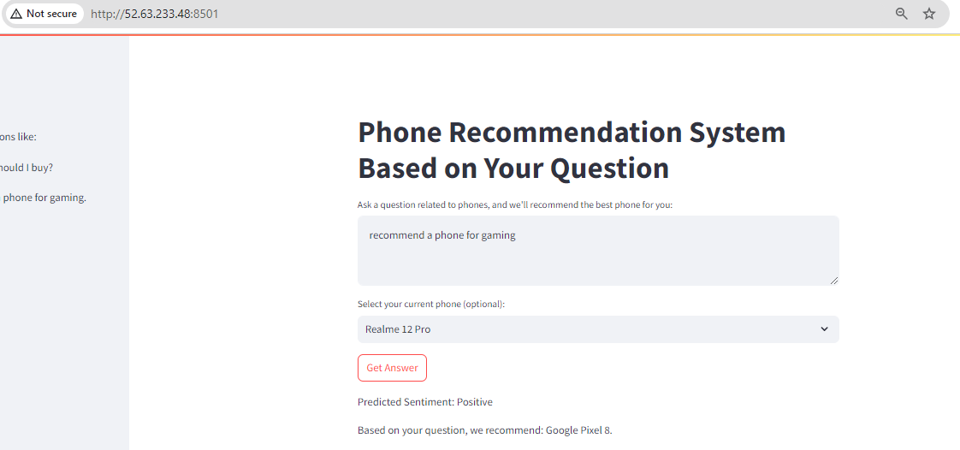
Deployment using AWS

Slide 9
THANK YOU

